Slide 1
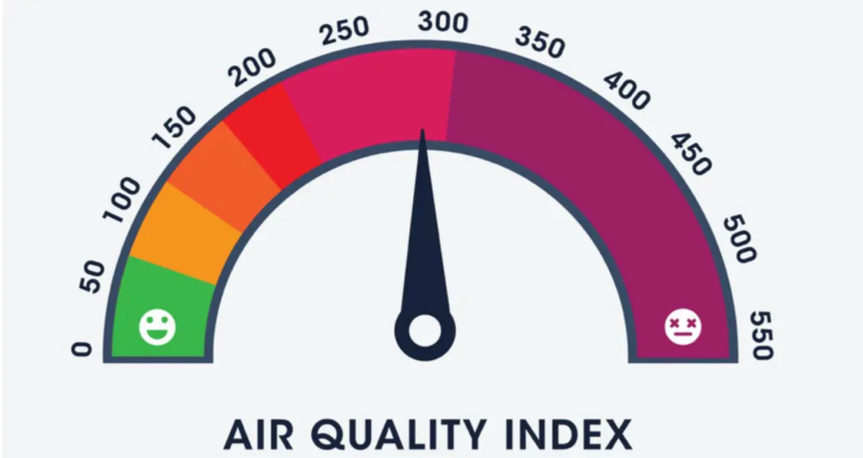
HYDERABAD AIR QUALITY INDEX
(How healthy is the air we breathe?)

Slide 2
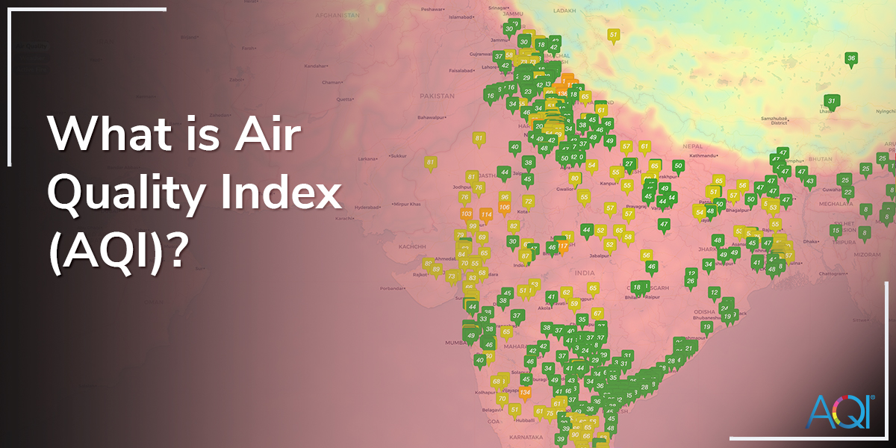
An air quality index is an indicator developed by government agencies to communicate to the public how polluted the air currently is or how polluted it is forecast to become.

Slide 3
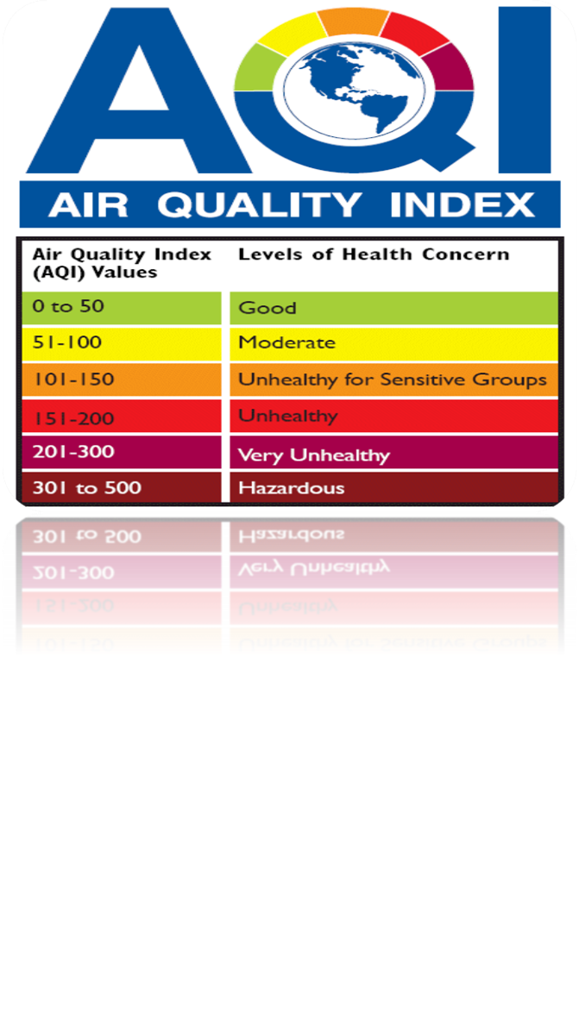
How do we know if Air Quality is poor?
AQI is an overall scheme that transforms individual air pollutant (e.g. SO₂, CO, PM₁₀) levels into a single number, which is a simple and lucid description of air quality for the citizens.
AQI relates to health impacts and citizens can avoid the unnecessary exposure to air pollutants;
AQI indicates compliance with National Air Quality Standards;
AQI prompts local authorities to take quick actions to improve air quality;
AQI guides policy makers to take broad decisions; and
AQI encourages citizens to participate in air quality management.

Slide 4

Are we affected by poor AQ?
1.The very young are at risk
-- Lungs are not fully developed
-- Faster breathing rate: more air volume/body weight
2.The very old are at risk
-- Undiagnosed lung or heart diseases
-- Pollution can exacerbate these conditions
3.Persons with chronic illnesses:
-- Respiratory circulatory, or cardiac diseases.
-- Even healthy persons can be affected when they exercise outdoors, or if the concentration of pollutants is very high

Slide 5
Pollutants Considered for AQI and Air Quality Standards
Pollutant | SO₂ | NO₂ | PM_{2.5} | PM₁₀ | O₃ |  | CO (mg/m³) |  | Pb | NH₃
Averaging time (hr) | 24 | 24 | 24 | 24 | 1 | 8 | 1 | 8 | 24 | 24
Indian Standard (µg/m³) | 80 | 80 | 60 | 100 | 180 | 100 | 4 | 2 | 1 | 400

Slide 6
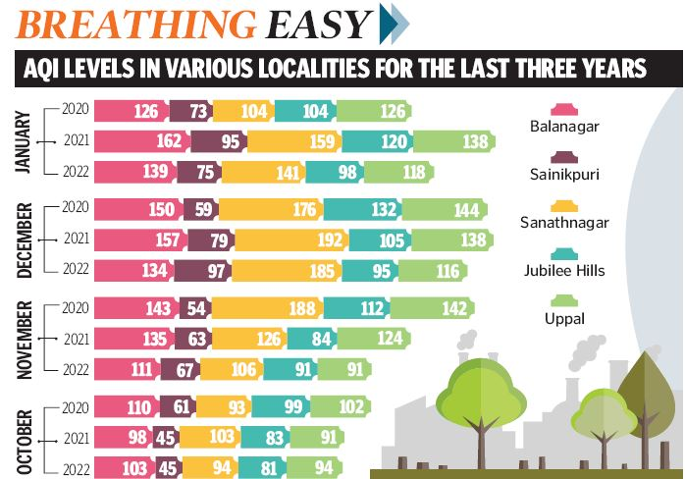
Air quality in Hyderabad
https://telanganatoday.com/air-quality-improves-in-hyderabad-2

Slide 7
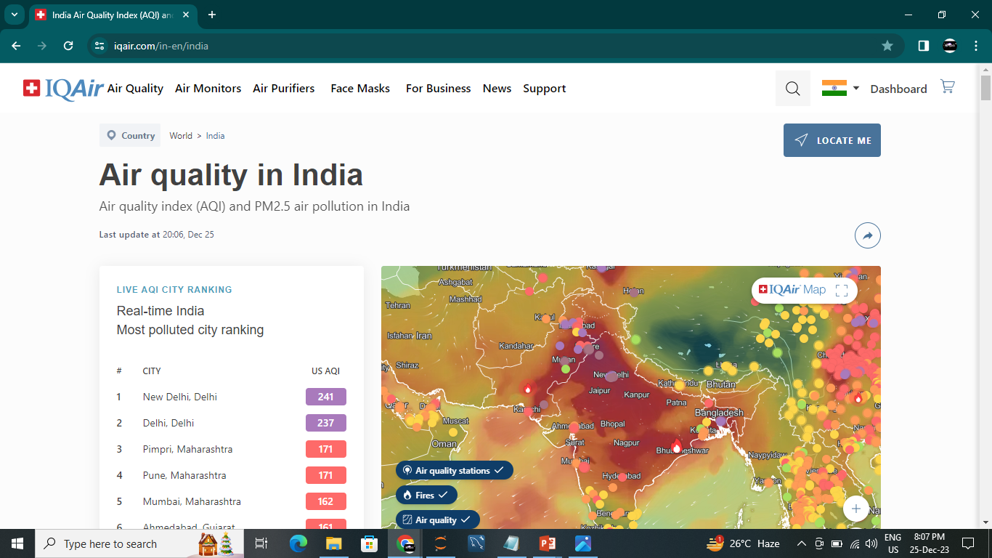
Web-based AQI dissemination
https://www.iqair.com/in-en/india

Slide 8
NowCast (Air quality index)
The PM NowCast is a weighted average of hourly air monitoring data used by the United States Environmental Protection Agency (USEPA) for real-time reporting of the Air Quality Index (AQI) for PM (PM₁₀ or PM_{2.5}).
Reference: US
Reference: India
https://cpcb.nic.in/
Reference: Telangana
https://tspcb.cgg.gov.in/default.aspx

Slide 9
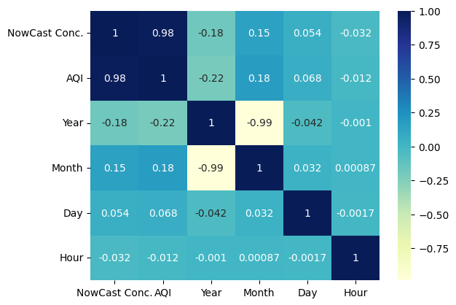
Correlation Matrix
The correlation matrix reveals strong positive correlation (0.98) between "NowCast Conc." and "AQI," indicating a significant relationship. Conversely, "Year" and "Month" exhibit negative correlations (-0.18 and -0.99, respectively), suggesting potential inverse associations. "Day" and "Hour" show weak correlations with other variables in the dataset.

Slide 10
Data Cleaning and Outlier Detection-NowCast Conc
Objective: Ensure data quality and handle outliers in NowCast Conc.
Quantile Calculation:
Q1 = 25th percentile
Q3 = 75th percentile
IQR (Interquartile Range) = Q3 - Q1
Outlier Thresholds:
Lower Bound = Q1 - 1.5 * IQR
Upper Bound = Q3 + 1.5 * IQR
Outlier Detection:
Identify outliers using threshold conditions
Outlier Handling:
Impute outliers in "NowCast Conc." with the mean
Result: Improved data quality for robust analysis.

Slide 11
Data Cleaning and Outlier Detection - AQI
Objective: Ensure data quality and handle outliers in "AQI“
Quantile Calculation:
Q1 = 25th percentile
Q3 = 75th percentile
IQR (Interquartile Range) = Q3 - Q1
Outlier Thresholds:
Lower Bound = Q1 - 1.5 * IQR
Upper Bound = Q3 + 1.5 * IQR
Outlier Detection:
Identify outliers using threshold conditions
Outlier Handling:
Impute outliers in "AQI" with the mean
Result: Enhanced data quality for robust AQI analysis.

Slide 12
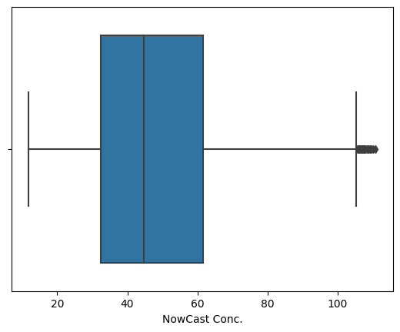
Boxplot Visualization - NowCast Conc.
Objective: Visualize the distribution of "NowCast Conc." to identify potential outliers
Boxplot Overview:
Utilizing seaborn library for data visualization
Focus on "NowCast Conc." variable
Boxplot Interpretation:
Central box represents interquartile range (IQR)
Whiskers show data distribution beyond the upper and lower quartiles
Outliers may be identified outside the whiskers
Insights:
Identify potential outliers in "NowCast Conc.“
Next Steps:
Evaluate outlier impact on analysis
Consider appropriate handling strategies
Result: Enhanced understanding of "NowCast Conc." distribution for data-driven decisions.

Slide 13
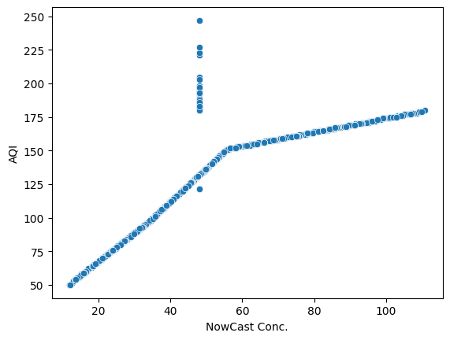
Scatterplot - NowCast Conc. vs. AQI
Objective: Explore the relationship between "NowCast Conc." and "AQI" using a scatterplot
Scatterplot Overview:
Utilizing seaborn library for data visualization
Axes represent "NowCast Conc." on the x-axis and "AQI" on the y-axis
Interpretation:
Each point represents a data pair (NowCast Conc., AQI)
Visualize the pattern and distribution of data points
Insights:
Identify any observable trends or correlations
Assess the strength and direction of the relationship
Next Steps:
Use insights to inform further analysis or modeling
Consider additional variables for a comprehensive understanding
Result: Enhanced understanding of the relationship between "NowCast Conc." and "AQI" for informed decision-making.

Slide 14
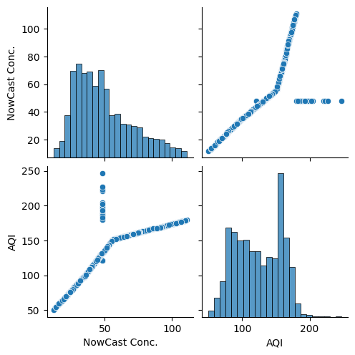
Pairplot - Exploring Relationships Across Variables
Objective: Utilize seaborn pairplot to visualize relationships among variables in the dataset
Pairplot Overview:
Utilizing seaborn library for comprehensive data exploration
Grid of scatterplots for each pair of variables in "a“
Interpretation:
Diagonal: Histograms representing the distribution of each variable
Off-diagonal: Scatterplots showing relationships between variable pairs
Insights:
Identify patterns, trends, and correlations across multiple variables
Next Steps:
Use insights to guide further analysis and modeling
Assess variable interactions for a holistic understanding
Result: Comprehensive visualization aiding in the exploration of relationships among variables.

Slide 15
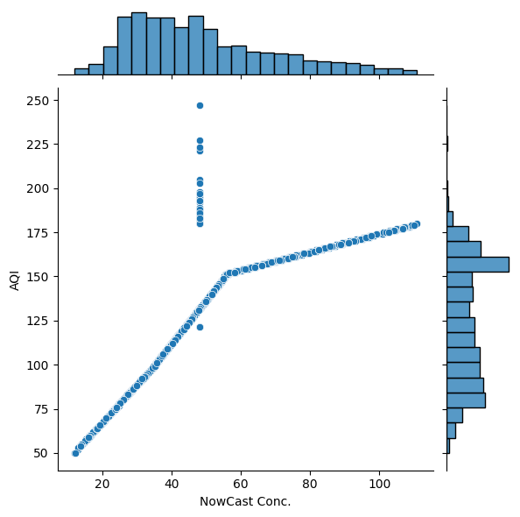
Jointplot - NowCast Conc. vs. AQI
Objective: Visualize the bivariate relationship between "NowCast Conc." and "AQI" using a seaborn jointplot
Jointplot Overview:
Utilizing seaborn library for bivariate data exploration
Axes represent "NowCast Conc." on the x-axis and "AQI" on the y-axis
Central scatterplot highlights the joint distribution of the two variables
Interpretation:
Assess the concentration of data points in the joint space
Identify any patterns or trends in the relationship
Insights:
Explore the strength and direction of the correlation between "NowCast Conc." and "AQI“
Next Steps:
Use insights to inform further analysis or modeling
Consider the visual representation for communication and reporting
Result: Enhanced understanding of the joint distribution of "NowCast Conc." and "AQI."

Slide 16
Linear Regression Modeling - NowCast Conc. vs. AQI
Objective: Utilize linear regression to model the relationship between "NowCast Conc." and "AQI“
Data Preparation:
Features (X): "NowCast Conc."
Target (Y): "AQI“
Data Splitting:
70% training set, 30% testing set
Random state set to ensure reproducibility (random_state=2)
Linear Regression Model:
Utilizing scikit-learn's LinearRegression module
Training the model on the training set
Prediction:
Making predictions on both the training and testing sets
Assessing model performance using R-squared (R²) metric
Result: A trained linear regression model predicting "AQI" based on "NowCast Conc." with insights into model performance.

Slide 17
Model Evaluation - R-squared Scores
Objective: Assess the performance of the Linear Regression model on training and testing sets
Evaluation Metrics:
R-squared (R²) Score
A measure of the proportion of variance explained by the model
Training Set Performance:
R-squared on the training set: 0.832
Testing Set Performance:
R-squared on the testing set: 0.830
Interpretation:
R² values close to 1 indicate a good fit
High consistency between predicted and actual values
Result: Strong model performance in explaining variability in "AQI" based on "NowCast Conc."

Slide 18
Model Evaluation - Regression Metrics
Objective: Calculate and assess additional evaluation metrics for the Linear Regression model
Evaluation Metrics:
Mean Absolute Error (MAE)
Mean Squared Error (MSE)
Root Mean Squared Error (RMSE)
Results:
Mean Absolute Error: 10.03
Mean Squared Error: 10.03
Root Mean Squared Error: 10.03
Interpretation:
Metrics quantify the average prediction errors
Useful for understanding model accuracy and performance
Low error metrics demonstrate model accuracy
Result: Insightful metrics providing a comprehensive view of the model's predictive accuracy.

Slide 19
Executive Summary
"Improve public health, ensure environmental compliance, and enhance community well-being with strategic air quality insights."
Public Health Improvement : Timely air quality insights lead to proactive measures, reducing health risks for the public.
2. Environmental Compliance : Monitoring ensures adherence to environmental regulations, safeguarding against penalties and legal issues.
3. Community Well-being Enhancement : Elevates community quality of life, fostering trust, and positive relationships through a commitment to environmental responsibility.

Slide 20
THANK YOU!
Done by :
Lokesh
AVS : Analytix Vidya and Solutions

